Slide 1
Company Presentation
CONFIDENTIAL
[ 1 ]

Slide 2
DISCLAIMER
This presentation has been prepared by Tamar Robotics Ltd. (the “Company”) and is general background information about the Company’s activities at the date of this presentation. The information in this presentation is provided in summary form only and does not purport to be complete. This presentation does not contain all the information that is or may be material to investors or potential investors and should not be considered as advice or a recommendation to investors or potential investors in respect of the holding, purchasing or selling of securities or other financial instruments and does not take into account any investor’s particular objectives, financial situation or needs.
By attending the presentation or by reading the presentation slides you agree to be bound as follows: This presentation has been made to you solely for information purposes. This presentation may be amended and supplemented as the Company sees fit, may not be relied upon for the purpose of entering into any transaction and should not be construed as, nor be relied on in connection with, any offer or invitation to purchase or subscribe for, underwrite or otherwise acquire, hold or dispose of any securities of the Company, and shall not be regarded as a recommendation in relation to any such transaction whatsoever. The contents of this presentation should not be considered to be legal, tax, investment or other advice, and any investor or prospective investor considering the purchase or disposal of any securities of the Company should consult with its own counsel and advisers as to all legal, tax, regulatory, financial and related matters concerning an investment in or a disposal of such securities and as to their suitability for such investor or prospective investor.
This presentation and its contents are confidential and proprietary to the Company, and no part of it or its subject matter may be reproduced, redistributed, passed on, or the contents otherwise divulged, directly or indirectly, to any other person (excluding the relevant person’s professional advisers) or published in whole or in part for any purpose without the prior written consent of the Company. If this presentation has been received in error it must be returned immediately to the Company.
This presentation does not constitute or form a part of any offer or solicitation to purchase or subscribe for securities under any applicable law, including without limitation the Israeli Securities Law 5728-1968 (the “Securities Law”). The securities referred to herein or offered in connection with this presentation have not been, and will not be, registered under the Securities Law. Neither the Israeli Securities and Exchange Commission nor any securities regulatory authority of any country has approved or disapproved of an investment in the securities or passed on the accuracy or adequacy of the contents of this presentation.
This presentation contains forward‐looking statements. These statements may include the words “believe”, “expect”, “anticipate”, “intend”, “plan”, “estimate”, “project”, “will”, “may”, “targeting” and similar expressions as well as statements other than statements of historical facts including, without limitation, those regarding the financial position, business strategy, plans, targets and objectives of the management of the Company for future operations (including development plans and objectives). Such forward‐looking statements involve known and unknown risks, uncertainties and other important factors which may affect the Company's ability to implement and achieve the economic and monetary policies, budgetary plans, fiscal guidelines and other development benchmarks set out in such forward‐looking statements and which may cause actual results, performance or achievements to be materially different from future results, performance or achievements expressed or implied by such forward‐looking statements. Such forward‐looking statements are based on numerous assumptions regarding the Company’s present and future policies and plans and the environment in which the Company will operate in the future. Furthermore, certain forward‐looking statements are based on assumptions or future events which may not prove to be accurate, and no reliance whatsoever should be placed on any forward-looking statements in this presentation. The forward‐looking statements in this presentation speak only as of the date of this presentation, and the Company expressly disclaims to the fullest extent permitted by law any obligation or undertaking to disseminate any updates or revisions to any forward‐looking statements contained herein to reflect any change in expectations with regard thereto or any change in events, conditions, or circumstances on which any such statements are based. Nothing in the foregoing is intended to or shall exclude any liability for, or remedy in respect of, fraudulent misrepresentation.
The information in this presentation has not been independently verified. No representation or warranty, express or implied, is made as to the fairness, accuracy or completeness of the presentation and the information contained herein and no reliance should be placed on it. Information in this presentation (including market data and statistical information) has been obtained from various sources (including third party sources) and the Company does not guarantee the accuracy or completeness of such information. All projections, valuations and statistical analyses are provided for information purposes only. They may be based on subjective assessments and assumptions and may use one among alternative methodologies that produce different results and to the extent they are based on historical information, any they should not be relied upon as an accurate prediction of future performance.
The information in this presentation is not intended to predict actual results and no assurances are given with respect thereto. None of the Company, its advisers, connected persons or any other person accepts any liability whatsoever for any loss howsoever arising, directly or indirectly, from this presentation or its contents. All information, opinions and estimates contained herein are given as of the date hereof and are subject to change without notice.

Slide 3
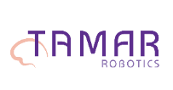
SURGICAL ROBOTICS IS IN OUR DNA
1
Founded in 2018 by world-renowned expert in medical robotics, Prof. Moshe Shoham
2
Prof. Shoham’s other brainchild companies include Mazor Robotics, XACT, ForSight Robotics & Diagnostic Robotics
3
To date, funding raised from Prof. Shoham, Mivtach Shamir, the Technion and private investors.
4
Following 5 years of research at the Technion - Israel Institute of Technology
[ 3 ]

Slide 4
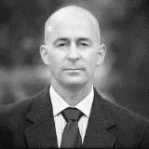
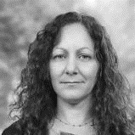
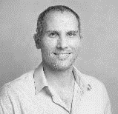
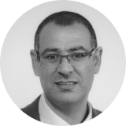
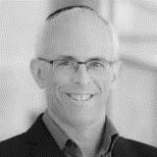
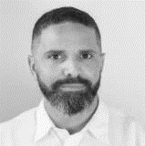
EXPERIENCED COMPANY LEADERSHIP
Noam Hassidov CEO & Director
15 years experience leading medical device startups. As former CEO of Motus GI (NASDAQ: MOTS), raised $15 million and took the company from pre-seed via CE Mark, to an 80-patient clinical study.
Dr. Hadas Ziso CTO
PhD in Medical Robotics, Technion-Israel Institute of Technology, where she published an award-winning research paper. Former application engineer at INSIGHTEC.
Dr. Avi Turgeman VP R&D
Former robotics department manager and chief system engineer at Mazor Robotics and experience in the defense industry developing semi-autonomous systems. B.Sc. in Elec. and M.Sc. in Robotics from the Technion. PhD in Robotics from Hamburg University of Technology.
Nizar Mishael CFO
Certified CPA and holds an MBA from Tel Aviv University. Experience in building +200 start-up companies, finance infrastructure for early and late-stage medical device companies. Managing Partner in NGT Healthcare 2.
Aaron Feldman VP Business Development
More than 20 years of experience in the medical device industry. Co-founder & CEO of Rafael Medical and 4 medical device companies. Previously Business Development Director of MST Surgical Robotics (acquired by Asensus Surgical).
Jonathan Harari Head of Regulatory Affairs
An expert Regulatory and QA specialist with over 12 years of experience in the medical device industry where he has supported leading companies as well as early-stage start-ups.

Slide 5
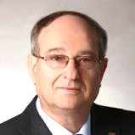
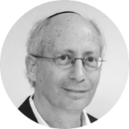
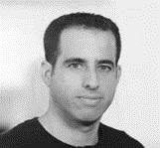
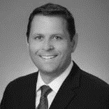
BOARD OF DIRECTORS
Prof. Peretz Lavie Director
President 2008-2019 of the Technion – Israel Institute of Technology. Pioneer in the Sleep Medicine field (sleep disorders) Former Dean of the Faculty of Medicine, Technion.
Prof. Moshe Shoham Director & Scientific Adviser
Heads the Robotics Laboratories, Mechanical Engineering Department, Columbia University, New York, and the Technion - Israel Institute of Technology, Haifa, Israel.
Guy Shamir Director
Head of BizDev, Technology and Real-Estate in MS Group, a TASE-traded company.Chairman of the Board: Menif Ltd. Director: Alon Tavor, Israel first private power plant, Bean & Co., Cellium, Diagnostic Robotics and Supplant.
Christopher Prentice
Director
Over 24 years as CEO, C-level executive and Board Member. Formerly Mazor U.S. subsidiary CEO, executive at Medtronic, J&J and the former Director of Sales - Intuitive Surgical. Currently CEO of Harmonic Bionics.
Noam Hassidov CEO & Director
15 years experience leading medical device startups. As former CEO of Motus GI (NASDAQ: MOTS), raised $15 million and took the company from pre-seed via CE Mark, to an 80-patient clinical study.

Slide 6
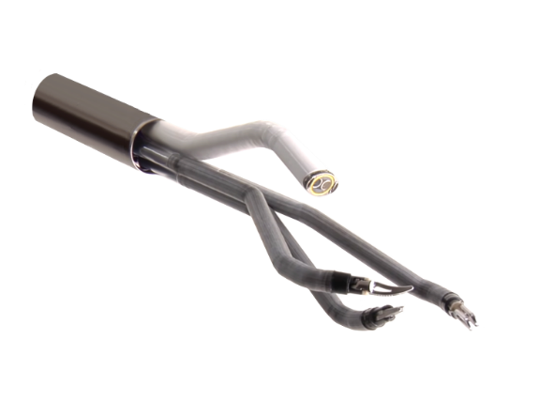
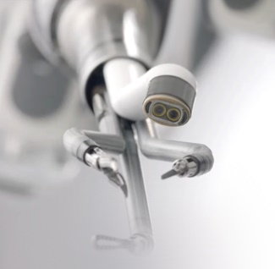
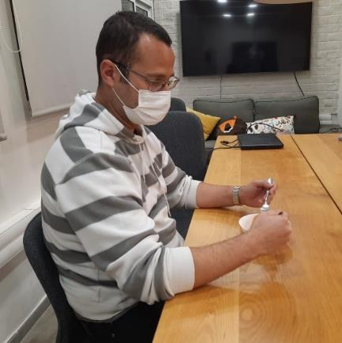
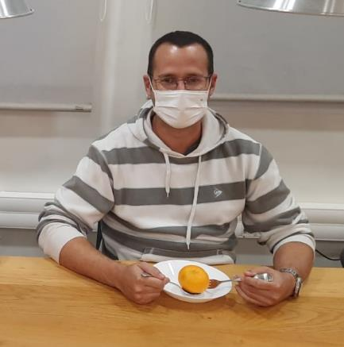
CURRENT ROBOTICS REQUIRE A LARGE WORKSPACE
25mm
Current robotic technology for robotic surgery affords excellent surgical results
“Arms and elbows” robot design requires a large workspace 100(L)X50(H)X50mm(W)
Sightline distance = 50mm
Elbow distance = 50mm
Limited to use for abdominal and thoracic procedures
All first-tier surgical robots face the same challenge
[ 6 ]

Slide 7
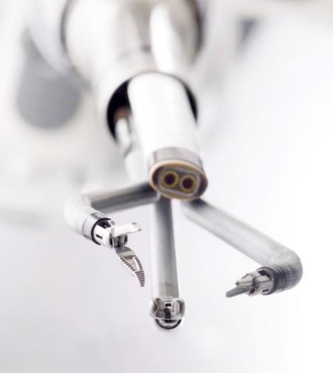
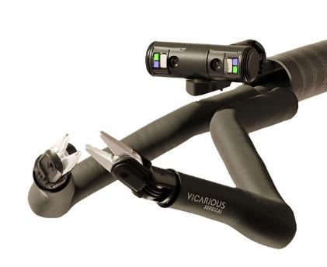
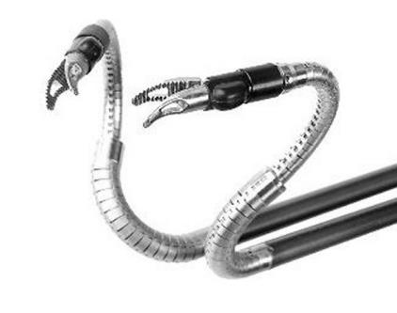
UNMET NEED: SMALL CAVITIES NEED A SMALL ROBOT
Da Vinci SP
Vicarious Surgical
Momentis (Memic)
25 mm
18 mm
15-20 mm
Current surgical robotics can only be used in large body cavities. Millions of patients undergoing “small cavity” surgery do not benefit from robotics.
[ 7 ]

Slide 8
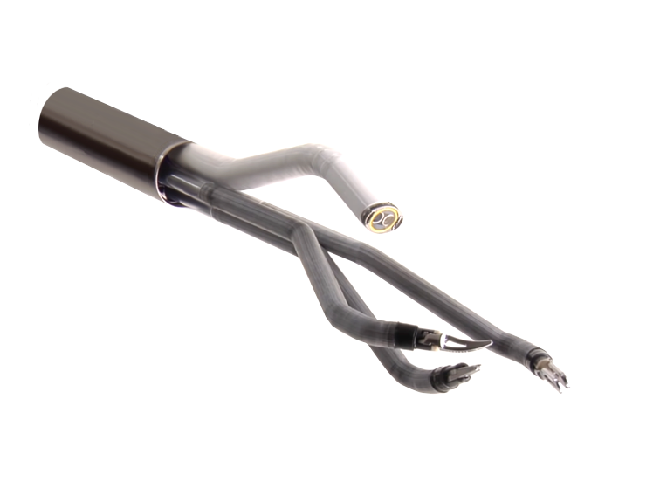
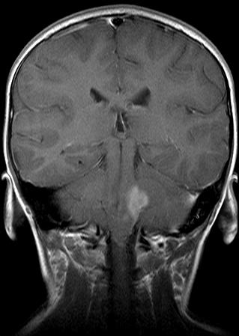
UNMET NEED: SMALL CAVITIES NEED A SMALL ROBOT
25
100 mm working length
mm
50 mm Hight
P = Prismatic, R = Revolute
[ 8 ]

Slide 9
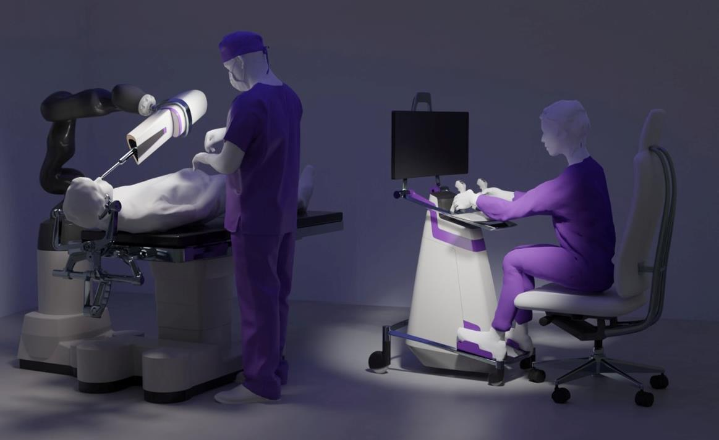
THE TAMAR ROBOTIC SYSTEM
Reduced
hand tremor
Scaled down
hand movement
Surgery without
CO₂ insufflation

Slide 10
INITIAL & FUTURE TARGETED PROCEDURES
Brain
Spine 3,500,000
Head & Neck 570,000
Urology 3,300,000
Thoracic 2,300,000
Pituitary
ICH
Skull Base/IVT
Metastases
Spinal Fusion
Lumbar Decompression
Tumors
Laryngeal Cancer
Thyroid Cancer
Bladder Cancer
Prostate Cancer
Lung and Bronchus Cancer
Unaddressed “Small Cavity” Procedures*
Annual incidence volumes Worldwide*
[1] https://www.cancer.org/content/dam/CRC/PDF/Public/8788.00.pdf
[2] https://www.ncbi.nlm.nih.gov/pmc/articles/PMC3443867/.
[3] Kimberly D. Miller, et al., Brain and other central nervous system tumor statistics, 2021
[4] Kerstin M Stenson, Epidemiology and risk factors for head and neck cancer

Slide 11
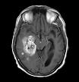
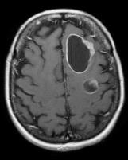
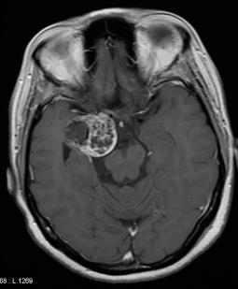
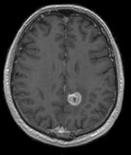
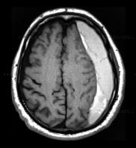
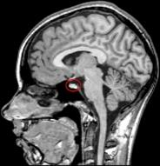
VALUE IN A RANGE OF BRAIN PROCEDURES
Malignant
Primary Brain Tumors
Pituitary Tumor
Skull Base Tumor
Intracranial Hemorrhage
Chronic Subdural Hemorrhage
Intraventricular Tumor
Metastatic Tumor
Glioma
GBM
Biopsies
Benign
Primary Brain Tumors
Skull Base
Brain Tumors
metastasis
Secondary Brain Tumors
ICH
Intra-Cranial Hemorrhage
c.SDH
Chronic Subdural Hemorrhage
Biopsy
Pituitary
Transsphenoidal Pituitary Tumors
[ 11 ]

Slide 12
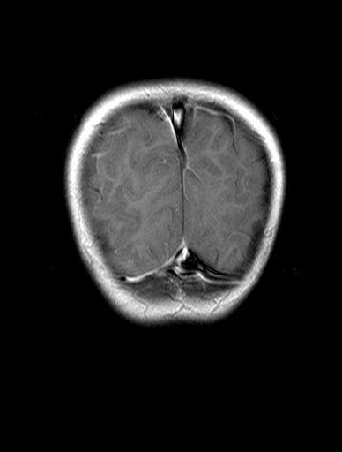
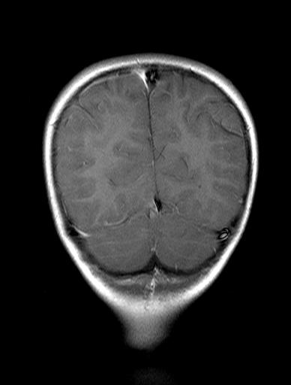
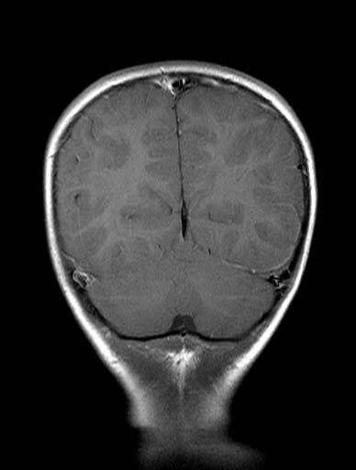
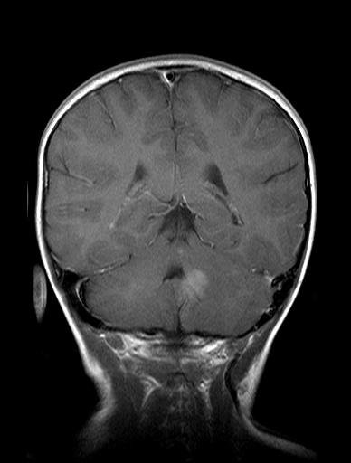
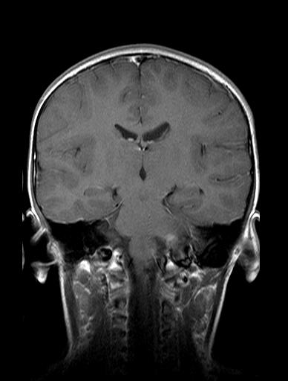
AI DECISION SUPPORT SOFTWARE
Using AI (Machine Learning) algorithms, the system can use existing sensor technology, generating new 3D data sets for intra-procedure functional brain mapping.
This capability is currently not
available in Neurosurgery and
can offer substantial clinical
benefit.
[ 12 ]

Slide 13
CLINICAL AND ECONOMIC VALUE FOR BRAIN SURGERY
Single access site
Improved visualization
Reduced bone drilling and reconstruction
BETTER RESECTION = improved clinical and economic outcomes
Reduced CSF leak & injury to critical structures
Surgeon full control and improved ergonomics
Maximal tumor removal
Reduced hospitalization and faster healing

Slide 14
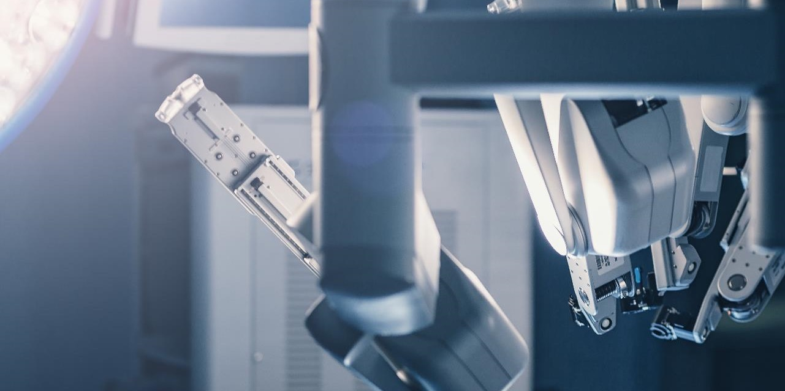
SURGICAL ROBOTICS GENERATING MAJOR DEALS
Mazor Robotics
Acquired by Medtronic
2018 - $1.6B
Auris Health
Acquired by J&J
2019 - $3.4B
Intuitive Surgical
(da Vinci robot)
Market cap
$95B
Momentis Surgical
Series D funding round
2021 - $96M
MAKO Surgical
Acquired by
Stryker
2013 - $1.65B
Corindus Vascular Robotics
Acquired by Siemens
2019 - $1.1B
CMR Surgical
Raised $240M in 3rd Round with a Valuation over
$1B
Vicarious Surgical
SPAC at a valuation of
2021 - $1.1B
CONFIDENTIAL
[ 14 ]

Slide 15
THE TAMAR VALUE PROPOSITION
Solves a major unaddressed need in the global healthcare market by bringing the benefits of robotic surgery to millions of patients undergoing small cavity procedures.
The only surgical robotic system that can accurately and safely remove tumors and other mass from the brain with no competing robotic system available.
Developed from the outset with input from leading KOLs and based on feedback from ~100 neurosurgeons: “it looks like the robot was developed by neurosurgeons”.
Highly experienced management, Board of Directors and SAB with demonstrated success in commercializing complex medical systems.
Extensive and robust IP portfolio covering a wide range of technologies serving as a significant barrier to entry.
[ 15 ]

Slide 16
Join us In transforming robotic surgery and improving patient care for millions of patients.
CONFIDENTIAL
[ 16 ]
Notes:
I would like to thank you for the opportunity to
present Tamar robotics.

