Slide 1
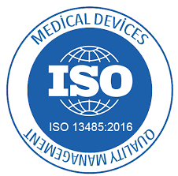

Slide 2
Use of
Proceeds
Clinical trials
FDA and CE approval
Development and production of first batch of medical watches;
Expending Intellectual Property
Initial Sales.
2

Slide 3
THANK YOU!
Eldad Shemesh, CEO
eldad@CardiacSense.com
+972.54.7000.824

