Slide 2
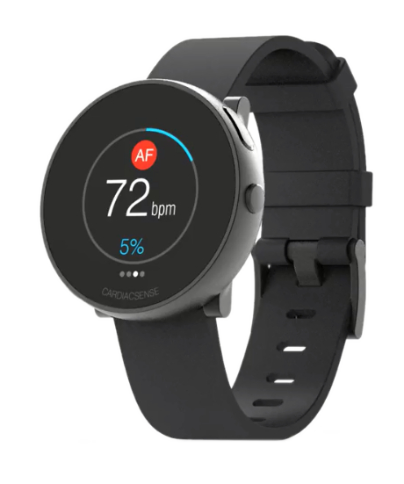
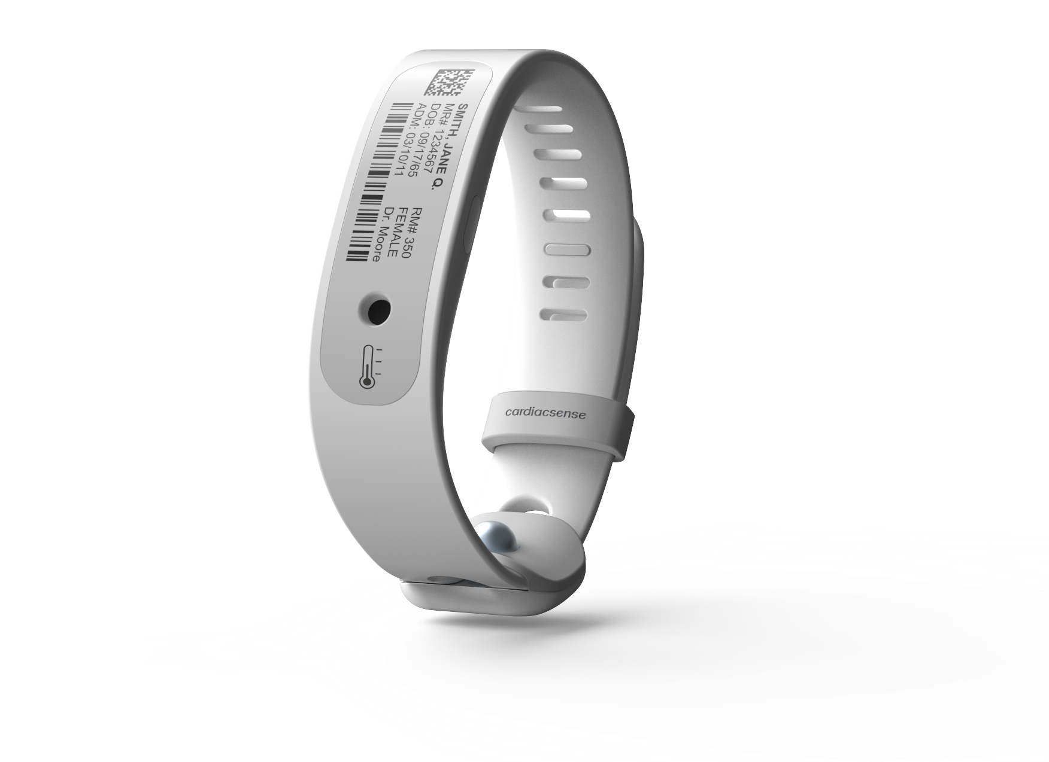
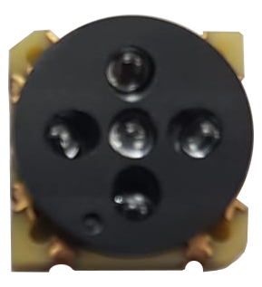
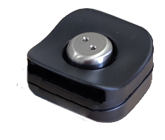
B2B Business Models
Timing | Market | Devices | Service providers | Partners | Payors | CPT codes
2020 | Out-of-hospital continuous, long-term arrhythmias (AF first) monitoring |  | Monitoring companies | Rhythm management companies | Insurance companies | 93229 93271
2021 | Out-of-hospital medically-driven vital sign monitoring |  | Monitoring companies HMOs | Bed-side monitoring companies | Insurance companies Private | 99453 - RPM 99454 - RPM 99457 – RPM 99487/89/90/91 – CCM
2021 | In-hospital vital sign monitoring |  | Hospitals Elderly houses rehabilitation centers | Bed-side monitoring companies | Hospitals | Part of DRG
2022 | Health-conscious consumers |  | Consumer watch companies Monitoring centers Without service |  | Private | Not needed
2

Slide 3
Selected Preliminary Partner Conversations
Cardiac Rhythm Management Device / Monitoring Companies | Other Med Tech / Monitoring Companies
Health Tech / Consumer Tech | Other
3

Slide 4
1A. Economics of CardiacSense medical watches to medical channel (subscription model)
1B. Economics of CardiacSense medical wristbands to hospitals (subscription model)
Medical watch sales price | $200 | per unit
Subscription fee for 36 months min. | $15 | per month
Medical watch cost | $130 | per unit
Development costs increase after 2021 | 10% | growth
Distributor support | 10% | of revenue
Medical Wristband sales price | 80$ | per unit
Patients with post-hospitalization monitoring | 10%
Subscription fee for 36 months minimum | 15$ | per month
Medical Wristband cost | 40$ | per unit
Development costs increase after 2021 | 10% | growth
Distributor support | 10% | of revenue
 | 2020 | 2021 | 2022 | 2023 | 2024
Units (in K) | 0 | 25 | 70 | 120 | 180
Cumulative Units (3 years) | 0 | 30 | 95 | 215 | 370
Revenue (in $K) | $0 | $9,500 | $31,100 | 62,700$ | 102,600$
Variable Costs | $0 | 3,250$ | 9,100$ | 15,600$ | 23,400$
Fixed Costs | $6,649 | $8,968 | $11,930 | $15,972 | $20,932
Profit before Taxes | ($6,649) | ($2,718) | $10,070 | $31,128 | $58,268
2020 | 2021 | 2022 | 2023 | 2024
0 | 50 | 500 | 1,000 | 2,000
0 | 50 | 550 | 1,550 | 3,500
0$ | 4,900$ | 49,900$ | 107,900$ | 223,000$
0$ | 2,000$ | 20,000$ | 40,000$ | 80,000$
0$ | 0$ | 0$ | 0$ | 0$
$0 | 2,900$ | 29,900$ | 67,900$ | 143,000$
Note: CardiacSense’s fixed costs are all captured in Business Model 1A, except direct costs for the Blood Pressure Clip
4

Slide 5
2. Economics of CardiacSense Blood Pressure clips to watch manufacturers
Probability Factor | 30%
Blood Pressure clip sales price | 80$ | per unit
Blood Pressure clip cost | 20$ | per unit
Development costs increase after 2021 | 10% | growth
Distributor support | 10% | of revenue
 | 2020 | 2021 | 2022 | 2023 | 2024
Units (in K) | 0 | 100 | 400 | 800 | 1200
Units (in K) after Probability Factor | 0 | 30 | 120 | 240 | 360
Revenue (in $K) | 0$ | 2,400$ | 9,600$ | 19,200$ | 28,800$
Variable Costs | 0$ | 600$ | $2,400 | 4,800$ | 7,200$
Fixed Costs | $984 | $1,420 | $2,258 | $3,218 | $4,178
Profit before Taxes | ($984) | $380 | $4,942 | $11,182 | $17,422
5

Slide 6
3. Economics of Strategic Partnerships
A. Licensing to Tier II players
B. Licensing to Tier I players
Algorithm license fee | $0.50 | per unit
Basic SOM* license fee | $1.00 | per unit
Advanced SOM* license fee | $1.50 | per unit
Unit growth per year | 10% | growth
Costs covered by licensee NRE
Advanced SOM* license fee | $1.50 | per unit
Unit growth per year | 19% | growth
Costs covered by licensee NRE
 | 2020 | 2021 | 2022 | 2023 | 2024
Algorithm License Units (in K) | 0 | 2,000 | 2,200 | 2,420 | 2,662
Basic SOM* License Units (in K) | 0 | 1,000 | 1,100 | 1,210 | 1,331
Advanced SOM* License Units (in K) | 0 | 1,000 | 1,100 | 1,210 | 1,331
Revenue (in $K) | $0 | $3,500 | $3,850 | $4,235 | $4,659
Profit before Taxes | $0 | $3,500 | $3,850 | $4,235 | $4,659
2020 | 2021 | 2022 | 2023 | 2024
0 | 2,860 | 3,403 | 4,050 | 4,820
$0 | $4,290 | $5,105 | $6,075 | $7,229
$0 | $4,290 | $5,105 | $6,075 | $7,229
*System-on-Module
6

Slide 7
 | 2020 | 2021 | 2022 | 2023 | 2024
Revenue | $0 | $9,500 | $31,100 | 62,700$ | 102,600$
Profit before Taxes | ($6,649) | ($2,718) | $10,070 | $31,128 | $58,268
Revenue | 0$ | 4,900$ | 49,900$ | 107,900$ | 223,000$
Profit before Taxes | $0 | $2,900 | $29,900 | $67,900 | $143,000
Revenue | $0 | 2,400$ | 9,600$ | 19,200$ | 28,800$
Profit before Taxes | ($984) | $380 | $4,942 | $11,182 | $17,422
Licensing to Tier II players
Revenue | 0$ | 3,500$ | 3,850$ | 4,235$ | 4,659$
Profit before Taxes | 0$ | 3,500$ | 3,850$ | 4,235$ | 4,659$
Revenue | $0 | $4,290 | $5,105 | $6,075 | $7,229
Profit before Taxes | $0 | $4,290 | $5,105 | $6,075 | $7,229
Total 1A-3B
Revenue | $0 | $24,590 | $99,555 | 200,110$ | 366,288$
Profit before Taxes | ($7,633) | $8,351 | $53,867 | $120,520 | $230,577
1A
CardiacSense medical watches to medical channel
Consolidated Economics across all 3 B2B business models (in $K)
1B
CardiacSense medical wristbands to hospitals
2
CardiacSense Blood Pressure clips to watch manufacturers
3A
Licensing to Tier I players
3B
7
7

